Slide 1
Bootstrap
components
Kanchana Jayendran

Slide 2
PREREQUISITES
Basic idea about web development
Knowledge about HTML
Basic and Advanced concept/idea of CSS.

Slide 3
LEARNING OBJECTIVE
FORMS
CARD
MODEL
NAV BAR
DISPLAY
BORDER
SHADOW

Slide 4
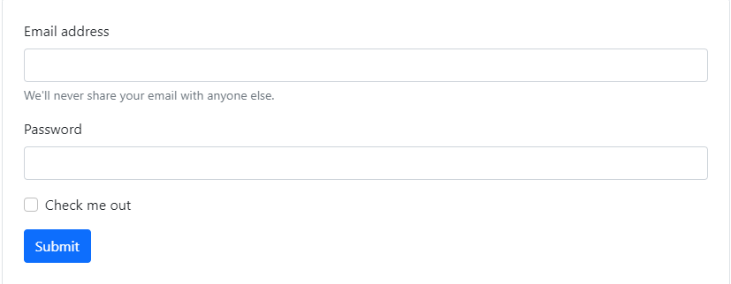
Forms
A form facilitate user to enter data such as name, email address, password etc, which can then be sent to server for processing.
Bootstrap provides classes to create a variety of forms with varied styles, layouts and custom components.

Slide 5
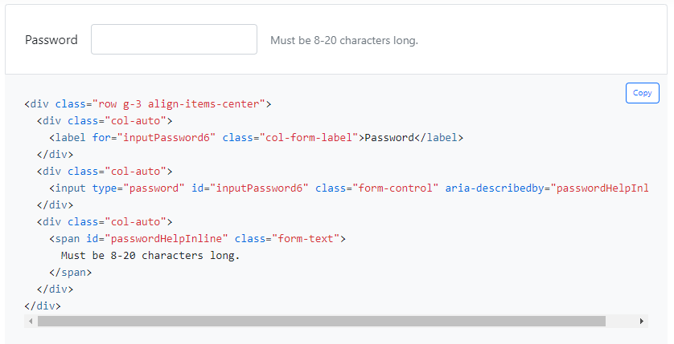
Form text
Form text below inputs can be styled with .form-text. If a block-level element will be used, a top margin is added for easy spacing from the inputs above.

Slide 6
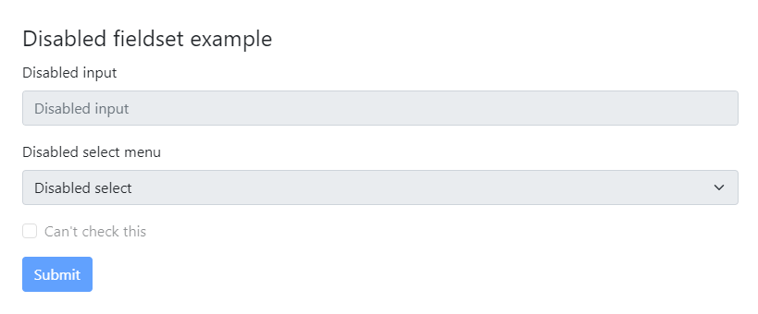
Disabled forms
Add the disabled attribute to a <fieldset> to disable all the controls within. Browsers treat all native form controls (<input>, <select>, and <button> elements) inside a <fieldset disabled> as disabled, preventing both keyboard and mouse interactions on them.

Slide 7
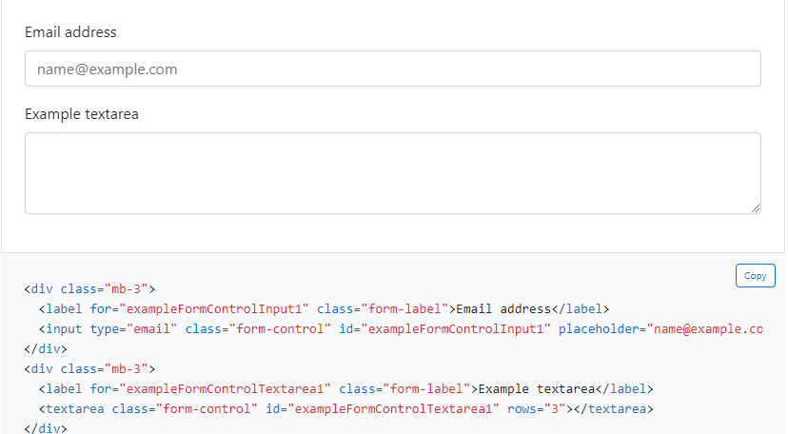
Form Control
Give textual form controls like <input>s and <textarea>s an upgrade with custom styles, sizing, focus states, and more.

Slide 8
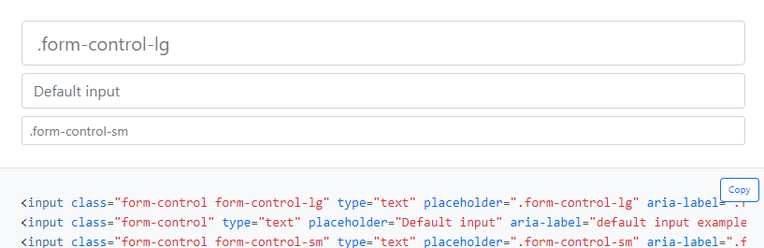
Sizing
Set heights using classes like .form-control-lg and .form-control-sm.

Slide 9
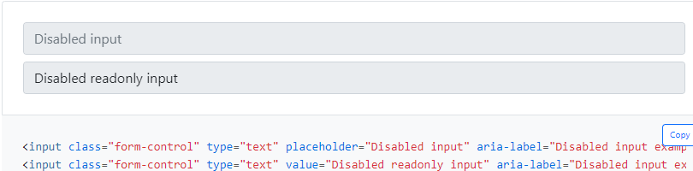
Disabled
Add the disabled boolean attribute on an input to give it a grayed out appearance and remove pointer events.

Slide 10
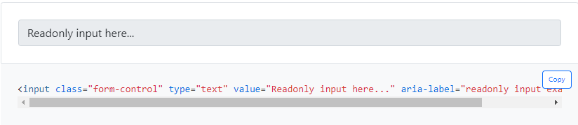
Readonly
Add the readonly boolean attribute on an input to prevent modification of the input’s value.

Slide 11
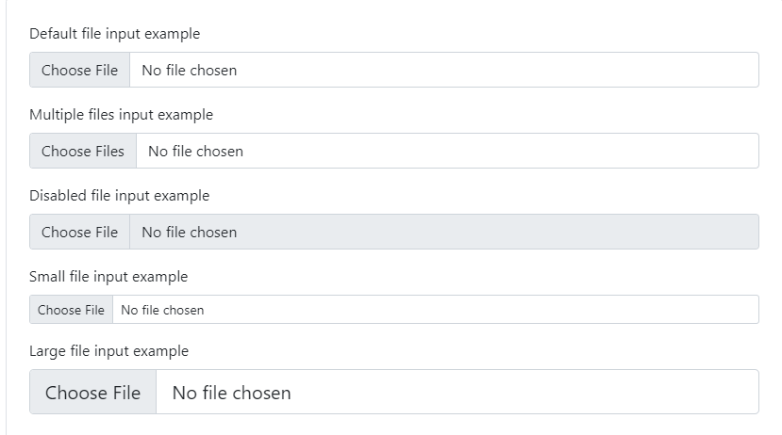
File input

Slide 12
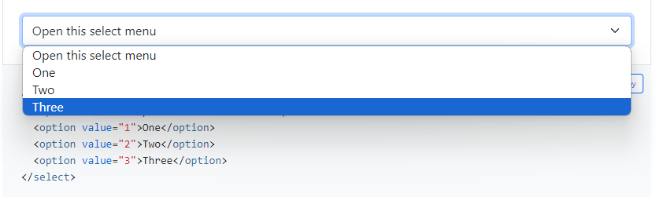
Select
Custom <select> menus need only a custom class, .form-select to trigger the custom styles.
Custom styles are limited to the <select>’s initial appearance and cannot modify the <option>s due to browser limitations.

Slide 13
Select
Sizing
You may also choose from small and large custom selects to match our similarly sized text inputs.
Disabled
Add the disabled boolean attribute on a select to give it a grayed out appearance and remove pointer events.

Slide 14
Checks & Radios
Bootstrap provides wrapper class .form-check for improved layout and behavior of browser default checkboxes and radios elements. It also allows greater customization and cross browser consistency.
.form-check-label class is used to show checkbox labels.
.form-check-input class is used for input type checkbox.

Slide 15
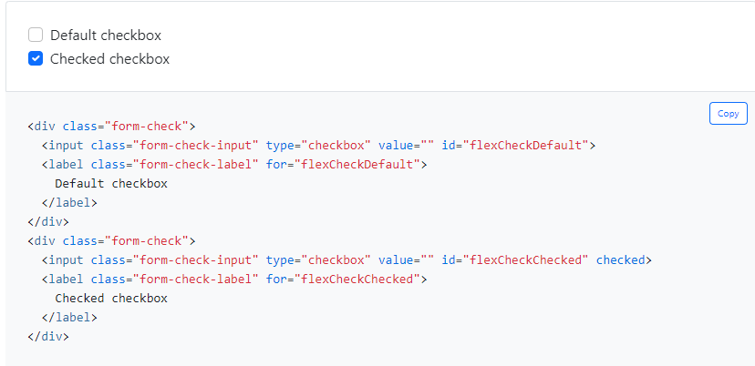
Checks

Slide 16
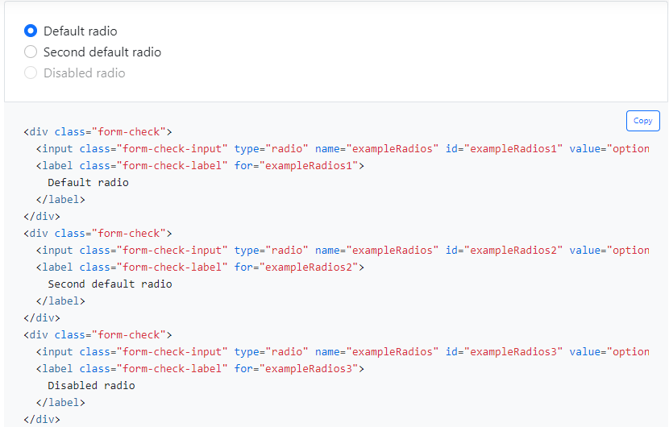
Radios

Slide 17
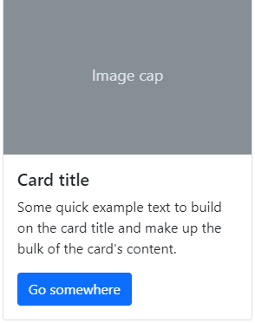
Card
To create a basic card use the class .card. Use spacing utilities when required because cards don't come with margins.
The basic card with mixed content and a fixed width is demonstrated here. Cards naturally cover the entire width of their parent element since they have no fixed width. With many sizing choices, this is easily customizable.

Slide 18
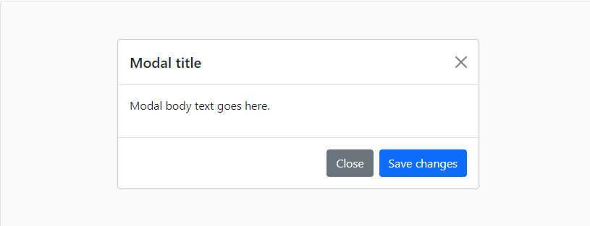
Model
Modals are a type of component that are used to display content or messages in a customizable dialog box that overlays the current page.

Slide 19
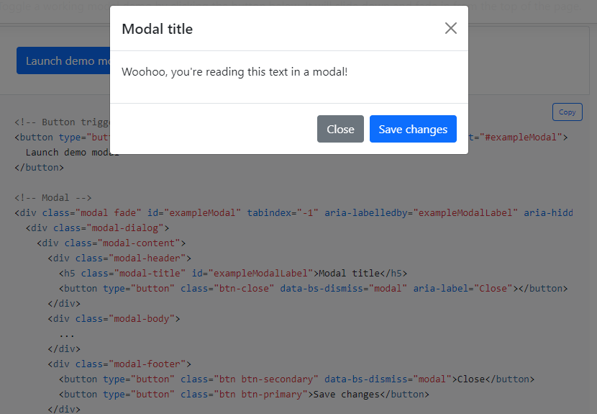
Model

Slide 20
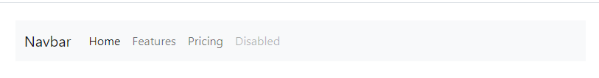
Nav Bar
Bootstrap's navbar is a powerful and responsive navigation header.
A navigation bar is a navigation header located at the top of the page.

Slide 21
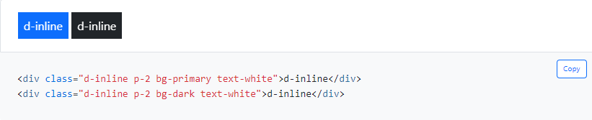
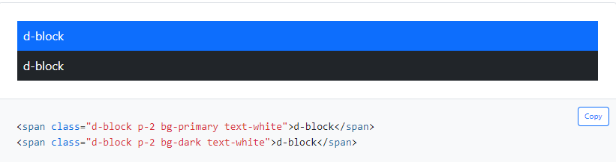
Display
The display property is used to control the visibility and behavior of elements.
It allows you to define how an element should be rendered and positioned within the document layout.

Slide 22
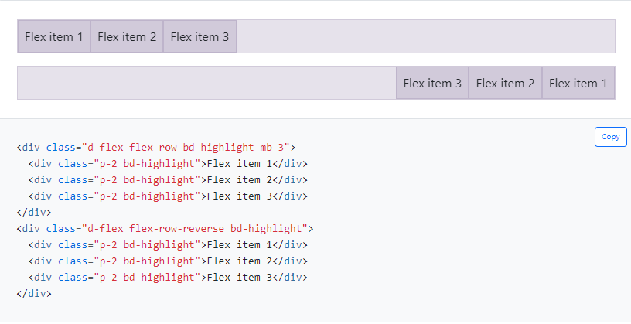
Flex
The .flex utility classes are helpful in quickly managing the layout, alignment and sizing of grid columns, navigation, components and much more
Direction
Justify content
Align item
Align self

Slide 23
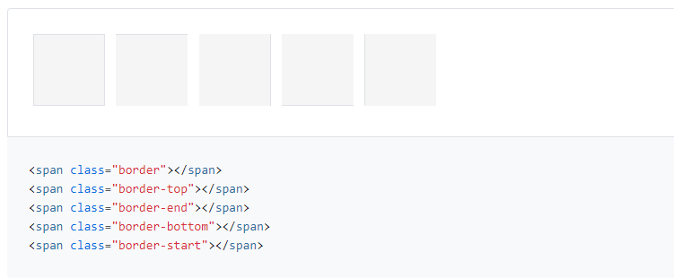
Border
Use border utilities to add or remove an element’s borders. Choose from all borders or one at a time.
Border Color
Border width
Border Radius
Border sizes

Slide 24
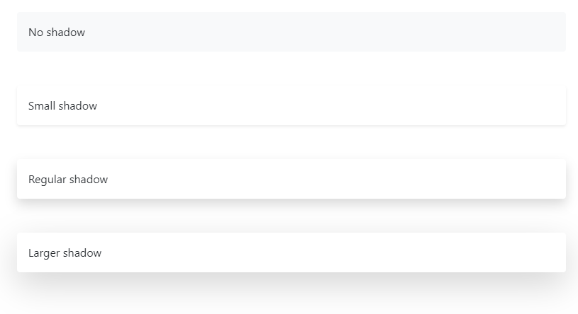
Shadow
Bootstrap provides a set of CSS classes that allows you to apply different types of box shadows to elements.

Slide 25
Thank you!

